Slide 1
Digital Portfolio
STUDENT NAME: E VIKRAM
REGISTER NO AND NMID: 24132251802521055, 38E44C215F371E18F934919718648A61
DEPARTMENT: B.Sc.COMPUTER SCIENCE
COLLEGE: GOVERNMENT ARTS AND SCIENCE COLLEGE,VANUR / ANNAMALAI UNIVERSITY

Slide 2
PROJECT TITLE
STUDENT DIGITAL PORTFOLIO

Slide 3


AGENDA
Problem Statement
Project Overview
End Users
Tools and Technologies
Portfolio design and Layout
Features and Functionality
Results and Screenshots
Conclusion
Github Link
3/21/2024 Annual Review

Slide 4

PROBLEM STATEMENT
Students often struggle to maintain and present their academic and non-academic achievements in an organized way. Traditional paper-based portfolios are difficult to update, lack interactivity, and cannot be easily shared.

Slide 5

PROJECT OVERVIEW
The Student Digital Portfolio is a web/app-based platform designed to help student collect, Organize and showcase their:
Academic records
Skills and Certification
Creative works(art, writing, photography, project etc.,)
Archivements and goals

Slide 6

WHO ARE THE END USERS?
Student -> Create and maintain portfolio
Teachers/Mentors -> Review and evaluate student progress
Recruiters/colleges -> Access student skills and achievements
Parents -> View student growth

Slide 7

TOOLS AND TECHNIQUES
Frontend: HTML,CSS, Javascript
Backend: PHP, Python, Node.js
Database: MySQL,MongoDB
Design Tools: Canva,Figma, Adobe XD
Version Control: Git/GitHub

Slide 8
POTFOLIO DESIGN AND LAYOUT
Home Page - Student intro, photo, motto
Academic Section - Marks, subjects, research project
Projects & Achievements - Project reports, competition, awards
Skills & Certification - Technical, soft skills, certificats
Creative Corners - Artworks, writings, performance
Reflections & Goals - personal growth statements, future plans
Contact Page - Email, Linkedln, QR code for sharing
8

Slide 9
FEATURES AND FUNCTIONALITY
User login & profile creation
Upload and organize documents, images and videos
Add/edit/delete portfolio entries
Search/filter archivements by category
Responsive design (works on mobile & desktop)
Share portfolio via link or QR code
Download portfolio as PDF (optional)

Slide 10
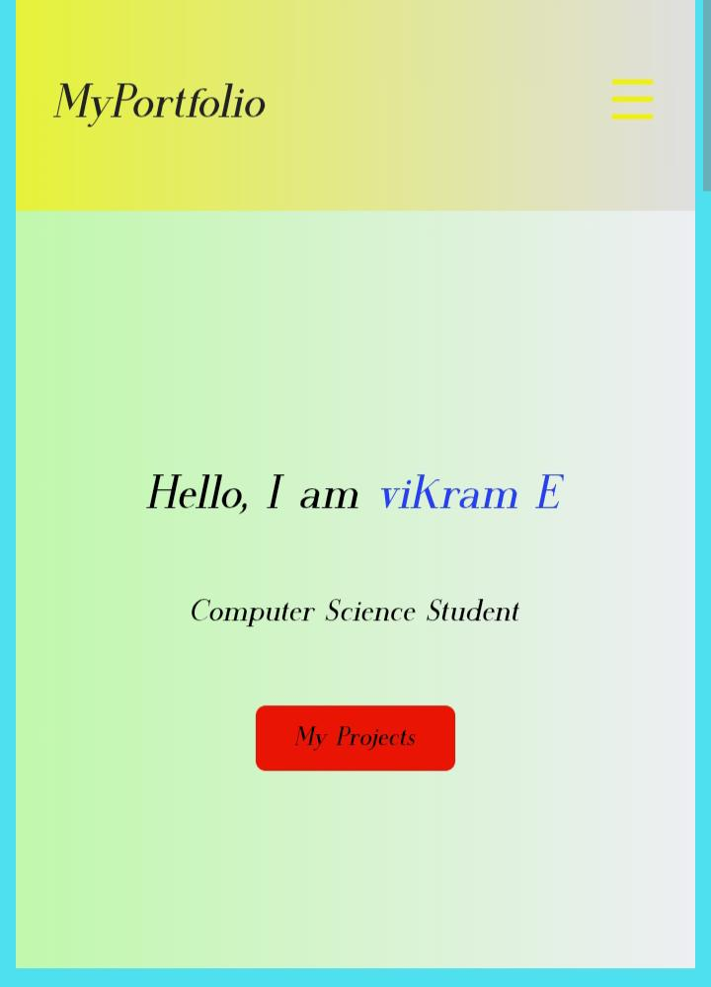
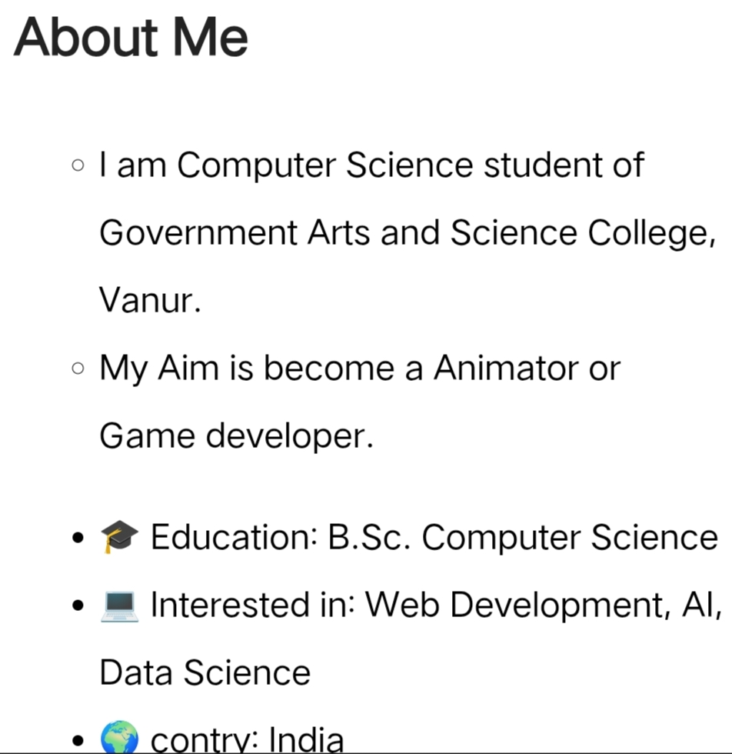

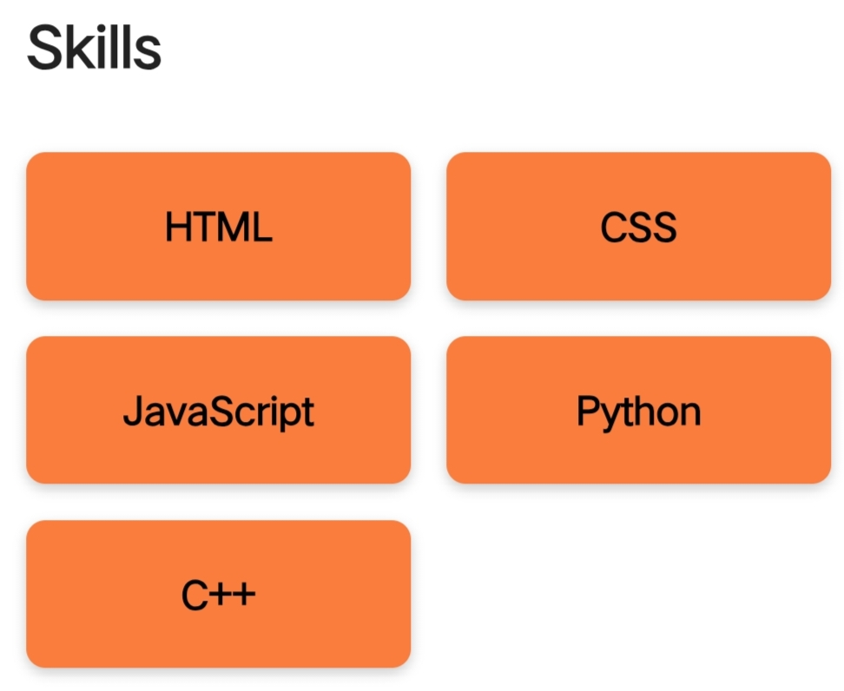
RESULTS AND SCREENSHOTS
3/21/2024 Annual Review
10

Slide 11
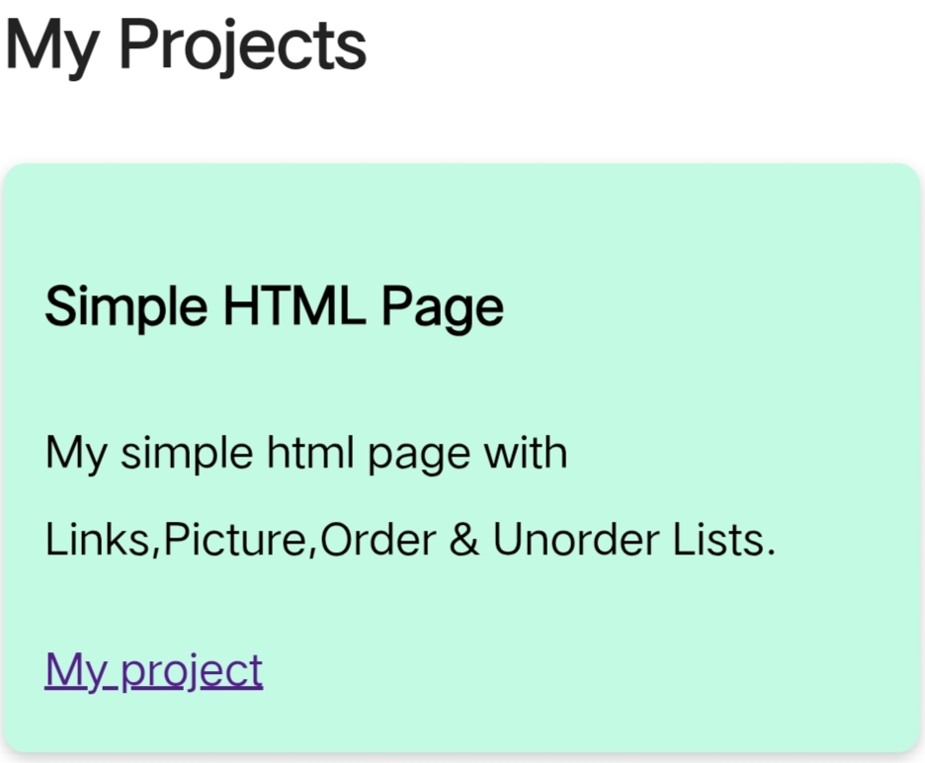
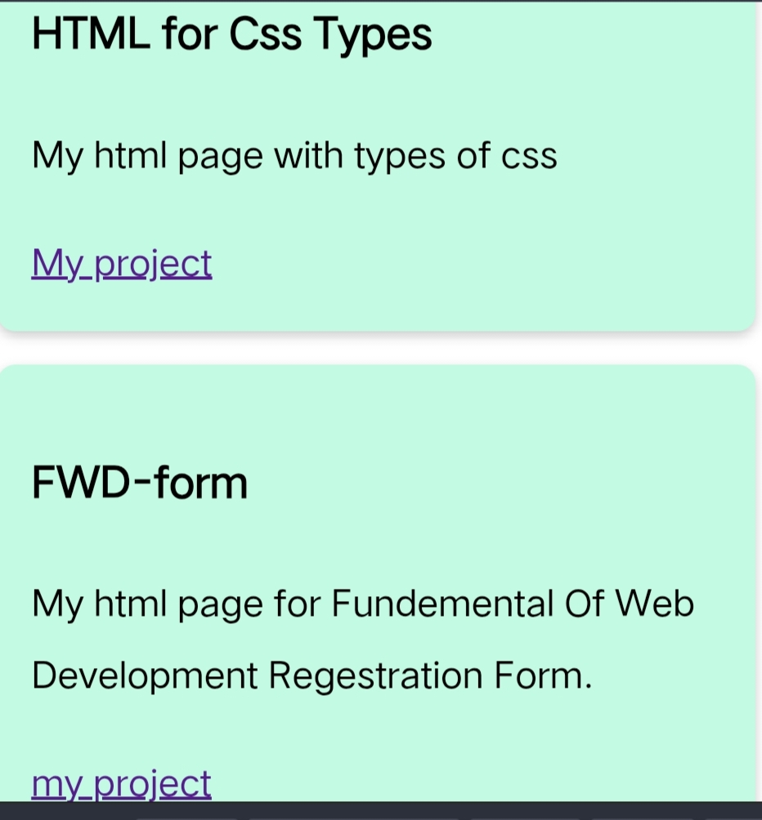
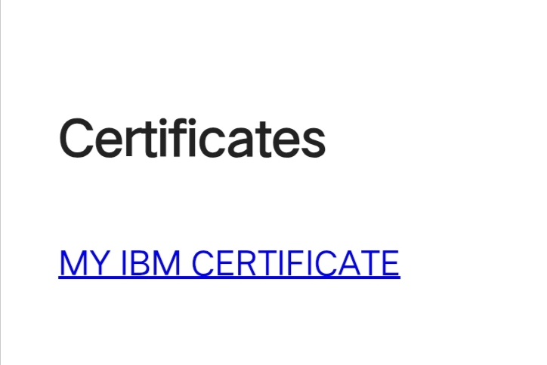
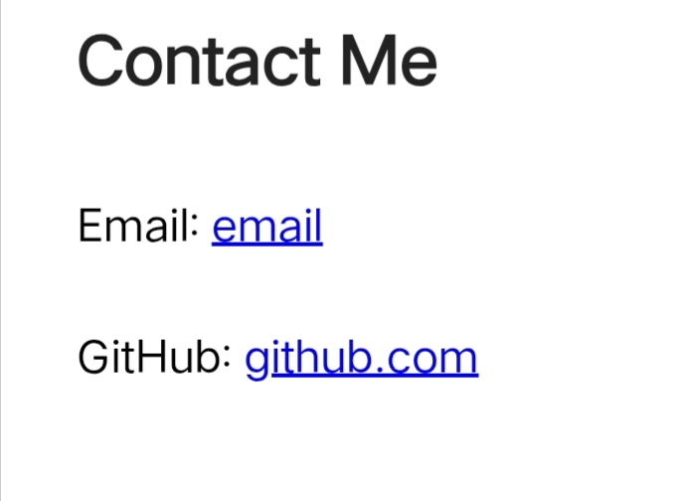
RESULTS AND SCREENSHOTS

Slide 12
CONCLUSION
The Student Digital Portfolio Project successfully provides a platform for students to showcase their academic and non-academic archivements in a structured, digital and professional format. It encourages self-reflection, improves presentation skills, and helps students in career and higher educational opportunities.
12

Slide 13
GITHUB LINK
https://www.credly.com/badges/9235902a-55b2-42be-992b-7d6f6248a596/public_url

